Slide 1
MULTIPLE BREAK REBAR
Advisor : Prof. K.C.Chang
Presenters : You-Ran Nai

Slide 2
OUTLINE
QUESTION REPLY
PAPER PROGRESS
PAPER
REVIEW

Slide 3
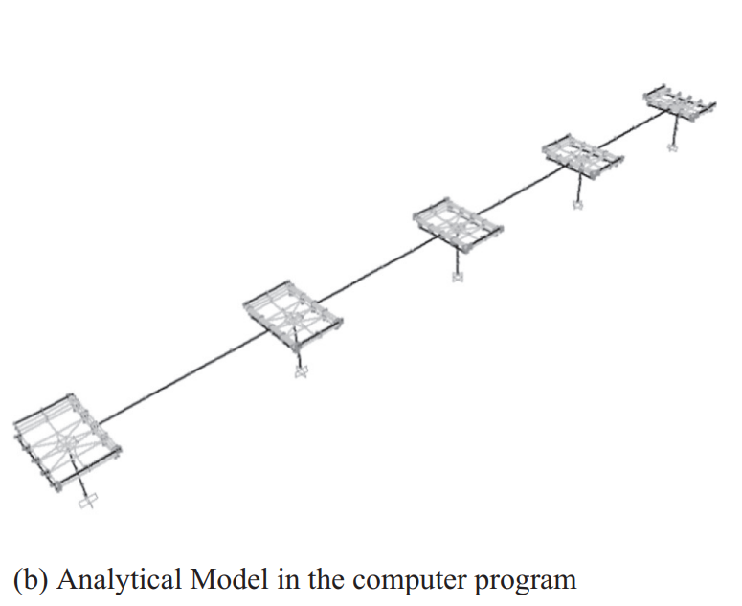
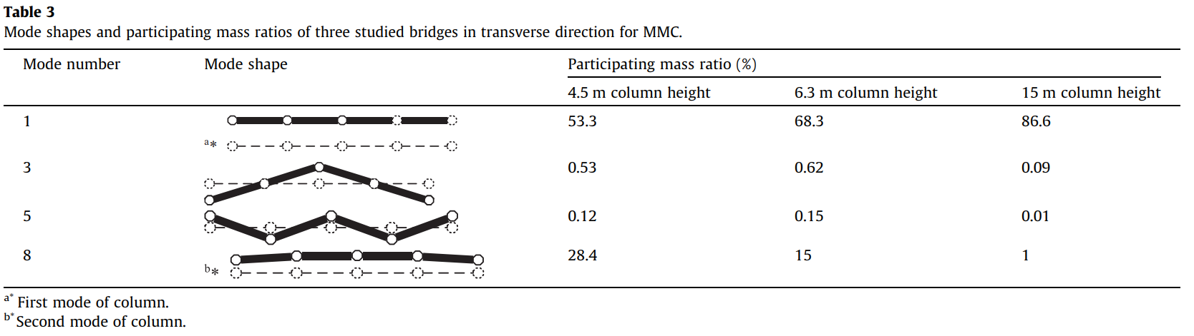
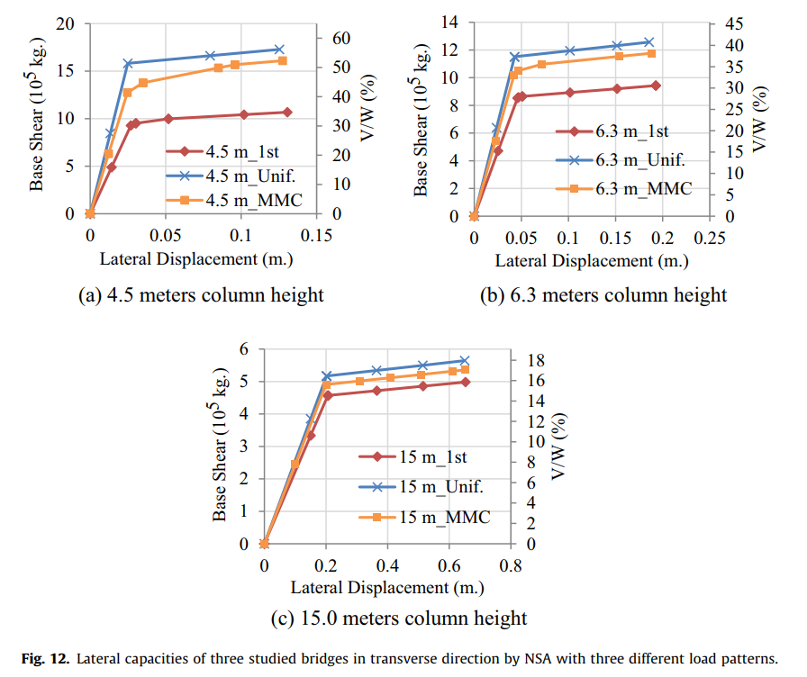
WHY ONE YIELDING OCCUR?
5 COLUMNS
SAME HEIGHT
TRANSVERSE DIRECTION
5 COLUMNS
SIMULTANEOUSLY YIELDING
ONE YIELDING
Incremental Dynamic Analysis with Multi-Modes for Seismic Performance Evaluation of RC Bridges

Slide 4
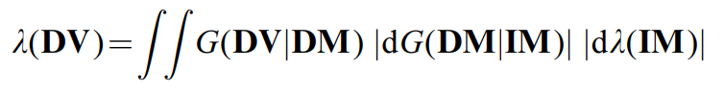
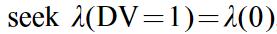
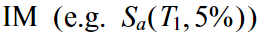
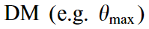
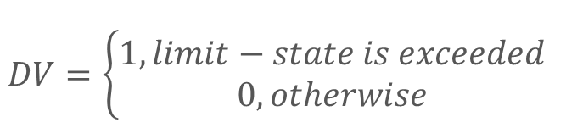

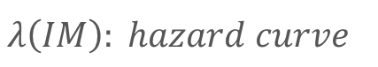
PBEE FRAMEWORK
$$DV=\left\{\begin{aligned}1, limit−state is exceeded \\ 0, otherwise\end{aligned}\right.$$
$$λ\left(IM\right): hazard curve$$
$$G\left(DM | IM\right):(conditional) complementary cumulative distribution$$
Incremental dynamic analysis

Slide 5
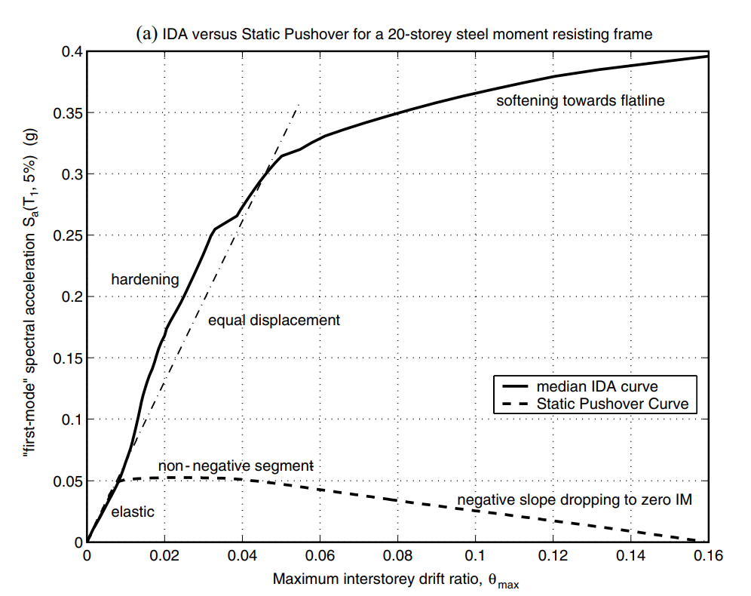
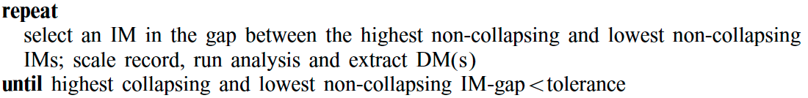
CAPACITY RESOLUTION
Furthermore, to improve upon the capacity resolution, a simple enhancement is to add a step-reducing routine, for example bisection, when collapse (e.g. non-convergence) is detected, so as to tighten the bracketing of the flatline.
<>
Incremental dynamic analysis

Slide 6
OUTLINE
1
2
3
4
FROM EXISTING REBAR (WITHOUT ETABS)
ETABS/SAP DEMAND
MULTI-MODES PUSHOVER
NONLINEAR TIME HISTORY ANALYSIS

Slide 7
PRECONDITION
LATERAL FORCE(EARTHQUAKE, WIND)
GRAVITY LOAD(DEAD, LIVE)
GIRDER
EARTHQUAKE VERTICAL FORCE
LATERAL EARTH PRESSURE, GROUND WATER PRESSURE, OR PRESSURE OF BULK MATERIALS

Slide 8
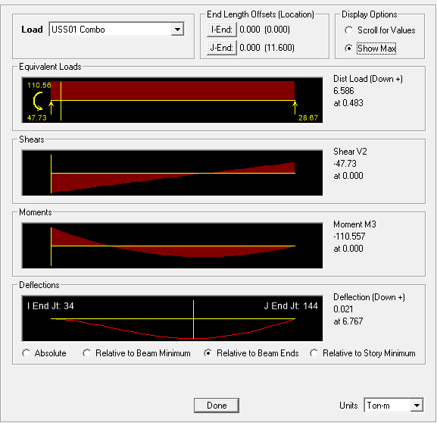

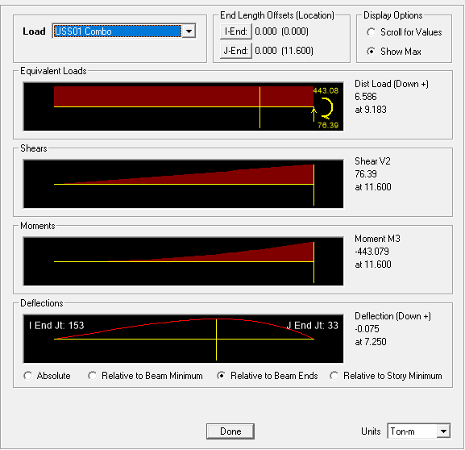

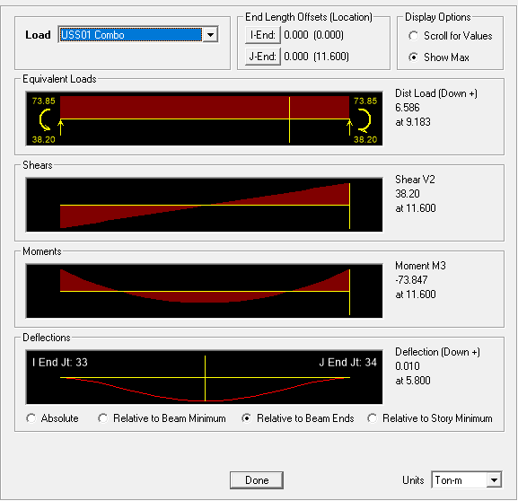

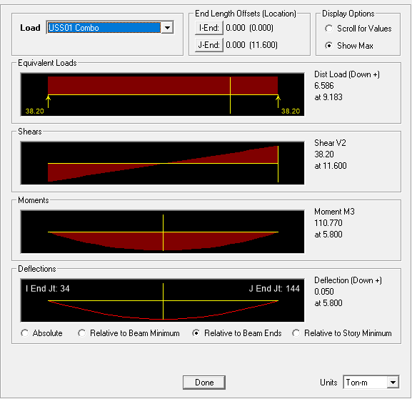

PRECONDITION
FIX-PIN
BOUNDARY CONDITION
FIX-FIX
FIX-FREE
PIN-PIN

Slide 9
TOP ALGORITHM
INITIAL TOP REBAR

Slide 10
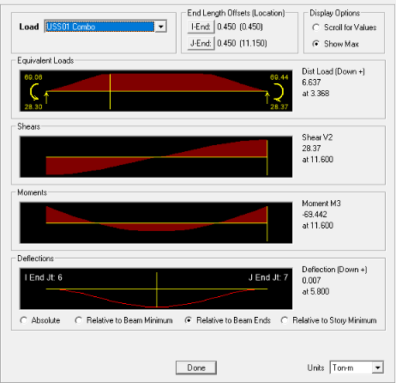
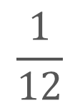
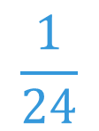
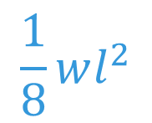
(SDL + SLAB) LL
BAND SPAN
$$\frac{1}{8}wl^{2}$$
➔
(1) U=1.4D
(2) U=1.2D + 1.6L
(3) U=1.2D + (1.0L or 0.5L)
(4) U=1.2D + 1.6W + (1.0L or 0.5L)
(5) U=1.2D + 1.0E + (1.0L or 0.5L)
(6) U=0.9D + 1.6W
(7) U=0.9D + 1.0E
50%
$$\frac{1}{12}$$
$$\frac{1}{24}$$
➔
➔
0.9D
IMPROVE: BIG DATA
SPAN STORY
0.9 * Mn = 0.9 * As * Fy * 0.9d >= Mu
94%

Slide 11
TOP ALGORITHM
(1) U=1.4D
(2) U=1.2D + 1.6L
(3) U=1.2D + (1.0L or 0.5L)
(4) U=1.2D + 1.6W + (1.0L or 0.5L)
(5) U=1.2D + 1.0E + (1.0L or 0.5L)
(6) U=0.9D + 1.6W
(7) U=0.9D + 1.0E
LATERAL
FORCE
GRAVITY LOAD

Slide 12
TOP ALGORITHM
(1) U=1.4D
(2) U=1.2D + 1.6L
(3) U=1.2D + (1.0L or 0.5L)
(4) U=1.2D + 1.6W + (1.0L or 0.5L)
(5) U=1.2D + 1.0E + (1.0L or 0.5L)
(6) U=0.9D + 1.6W
(7) U=0.9D + 1.0E
LATERAL
FORCE
GRAVITY LOAD

Slide 13
ALGORITHM
CHANGE TO
REBAR NUMBER
LINEAR ADD

Slide 14
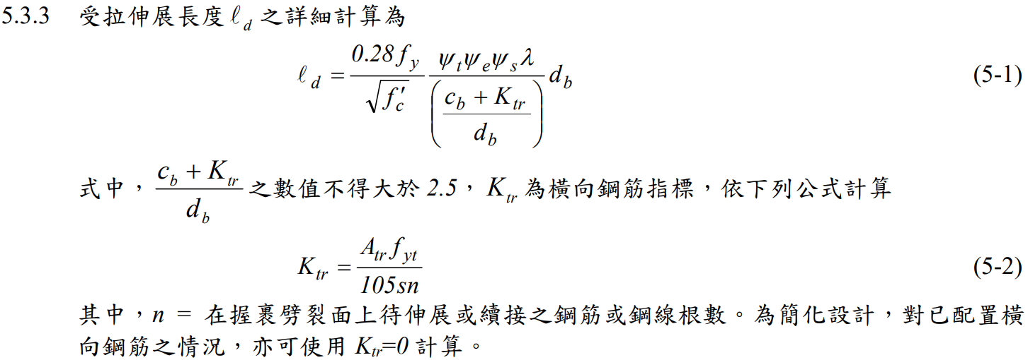
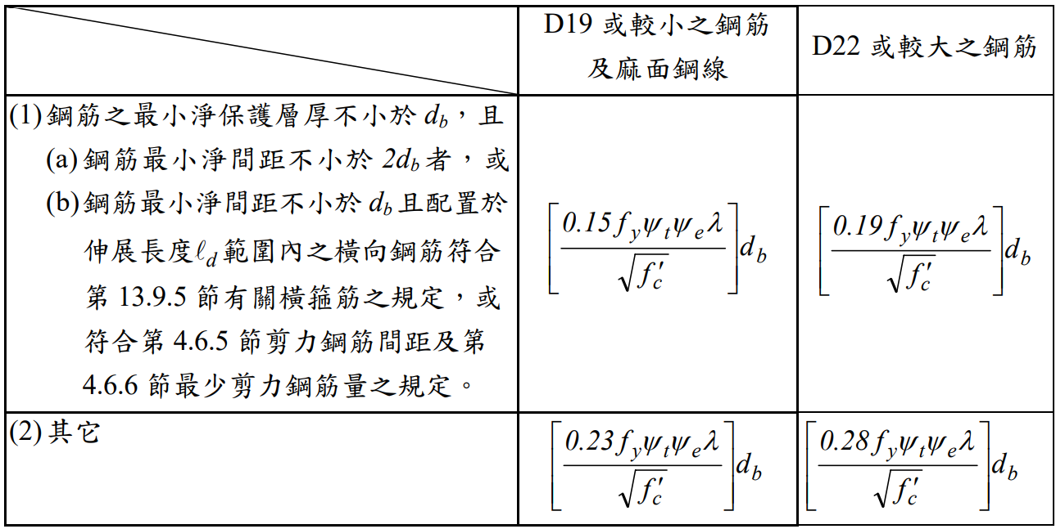
GENERAL DEVELOPMENT LENGTH EQUATION
DEVELOPMENT LENGTH
MIN
➔
SIMPLIFIED PROVISIONS
Beam width, cover, Fy, Fyt, Fc’,
Rebar‘s Db, Stirrup’s Db,
Spacing, rebar number

Slide 15
ALGORITHM
BEFORE
REDUCE TO THREE POINTS
AFTER
FINITE PERMUTATION
0.15~0.4
AVOID EXTREME SITUATION
IMPROVE: REDUCE PERMUTATION
0.15~0.4
0.6~0.85

Slide 16
BOT ALGORITHM
INITIAL BOT REBAR

Slide 17
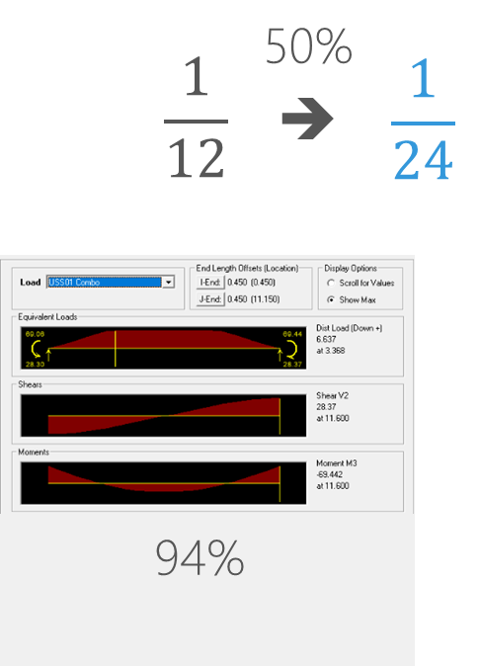
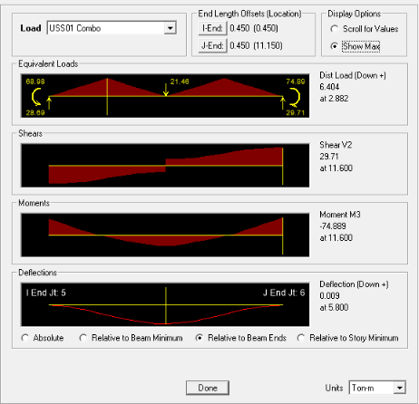
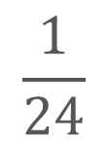
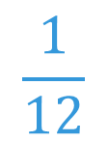

(SDL + SLAB) LL
BAND SPAN
$$\frac{1}{8}wl^{2}$$
➔
(1) U=1.4D
(2) U=1.2D + 1.6L
(3) U=1.2D + (1.0L or 0.5L)
(4) U=1.2D + 1.6W + (1.0L or 0.5L)
(5) U=1.2D + 1.0E + (1.0L or 0.5L)
(6) U=0.9D + 1.6W
(7) U=0.9D + 1.0E
50%
$$\frac{1}{24}$$
$$\frac{1}{12}$$
➔
➔
1.2D + 1.6L
IMPROVE: BIG DATA
SPAN STORY
0.9 * Mn = 0.9 * As * Fy * 0.9d >= Mu
119%
Notes:
Span 較短

Slide 18
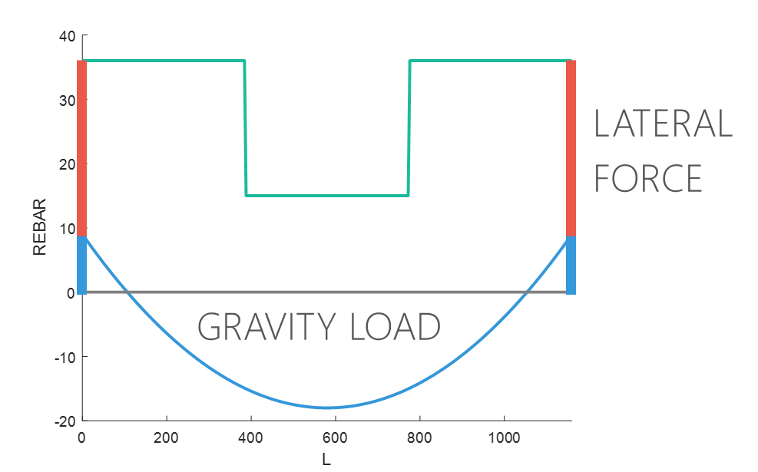
BOT ALGORITHM
DIFFERENT FROM TOP
(1) U=1.4D
(2) U=1.2D + 1.6L
(3) U=1.2D + (1.0L or 0.5L)
(4) U=1.2D + 1.6W + (1.0L or 0.5L)
(5) U=1.2D + 1.0E + (1.0L or 0.5L)
(6) U=0.9D + 1.6W
(7) U=0.9D + 1.0E
GRAVITY LOAD
LATERAL
FORCE

Slide 19
ALGORITHM
CHANGE TO
REBAR NUMBER
LINEAR ADD
IMPROVE: FROM ETABS REAL DEMAND TO VERIFY

Slide 20
GENERAL DEVELOPMENT LENGTH EQUATION
DEVELOPMENT LENGTH
MIN
➔
SIMPLIFIED PROVISIONS
Beam width, cover, Fy, Fyt, Fc’,
Rebar‘s Db, Stirrup’s Db,
Spacing, rebar number

Slide 21
ALGORITHM
REDUCE TO THREE POINTS
FINITE PERMUTATION
0.15~0.4
AFTER
AVOID EXTREME SITUATION
BEFORE
IMPROVE: REDUCE PERMUTATION
0.15~0.4
0.6~0.85

Slide 22
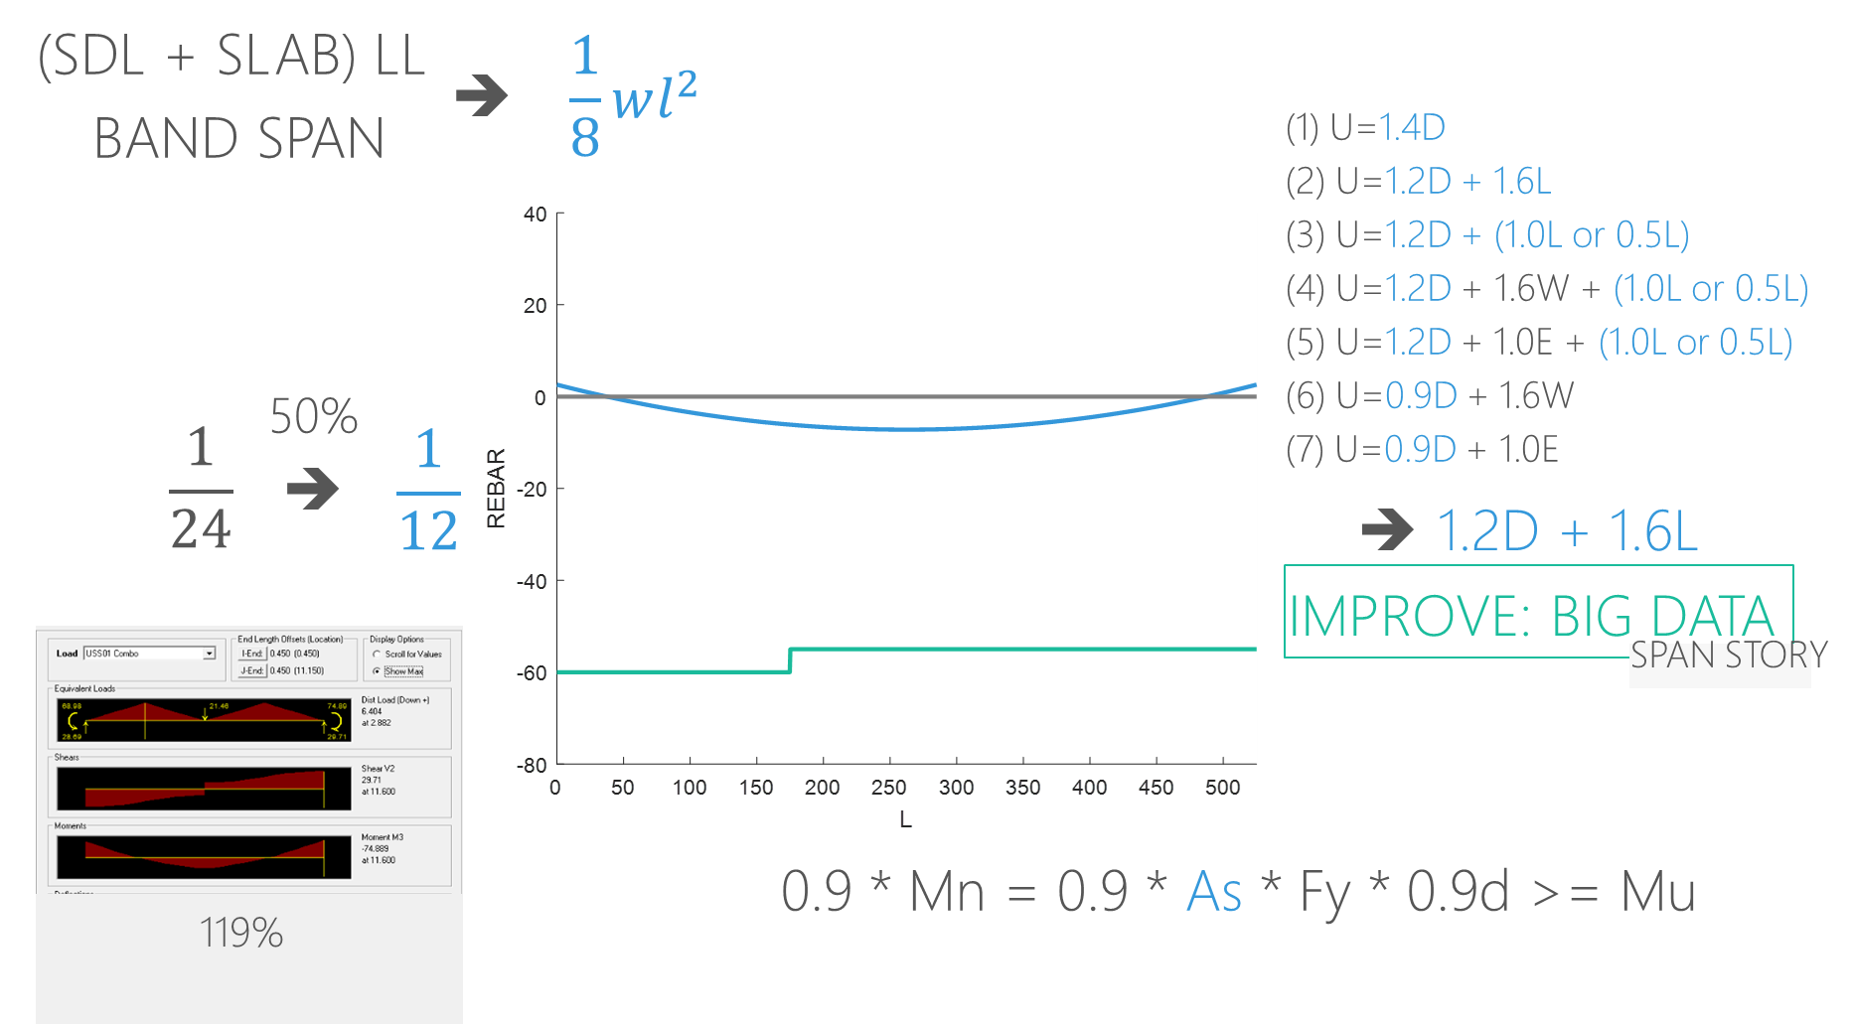
THE OTHER CASE
NORMAL GRAVITY LOAD
TOO CONSERVATIVE
MORE THAN INITIAL REBAR
➔
➔
➔
➔

Slide 23
THE OTHER CASE
MAX
➔
MAX
MAX
1/3
2/3
1/4
3/4
1/4
3/4

Slide 24
GENERAL DEVELOPMENT LENGTH EQUATION
DEVELOPMENT LENGTH
MIN
➔
SIMPLIFIED PROVISIONS
Beam width, cover, Fy, Fyt, Fc’,
Rebar‘s Db, Stirrup’s Db,
Spacing, rebar number

Slide 25
BEFORE
=
AFTER
+
IMPROVE: CONSTRUCTION COST ASSESSMENT

Slide 26
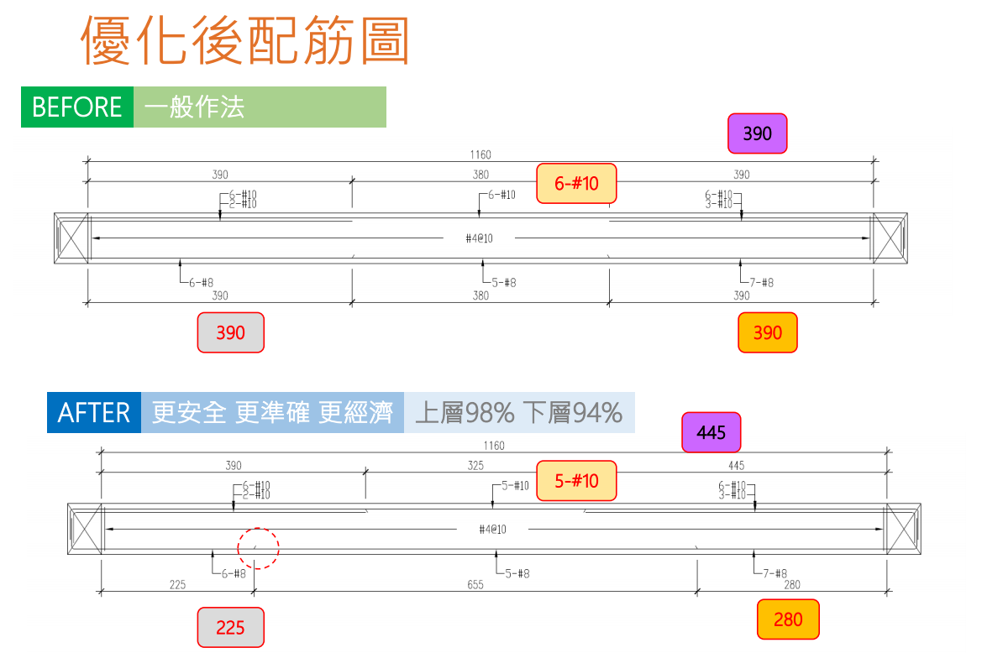
RCAD

Slide 27
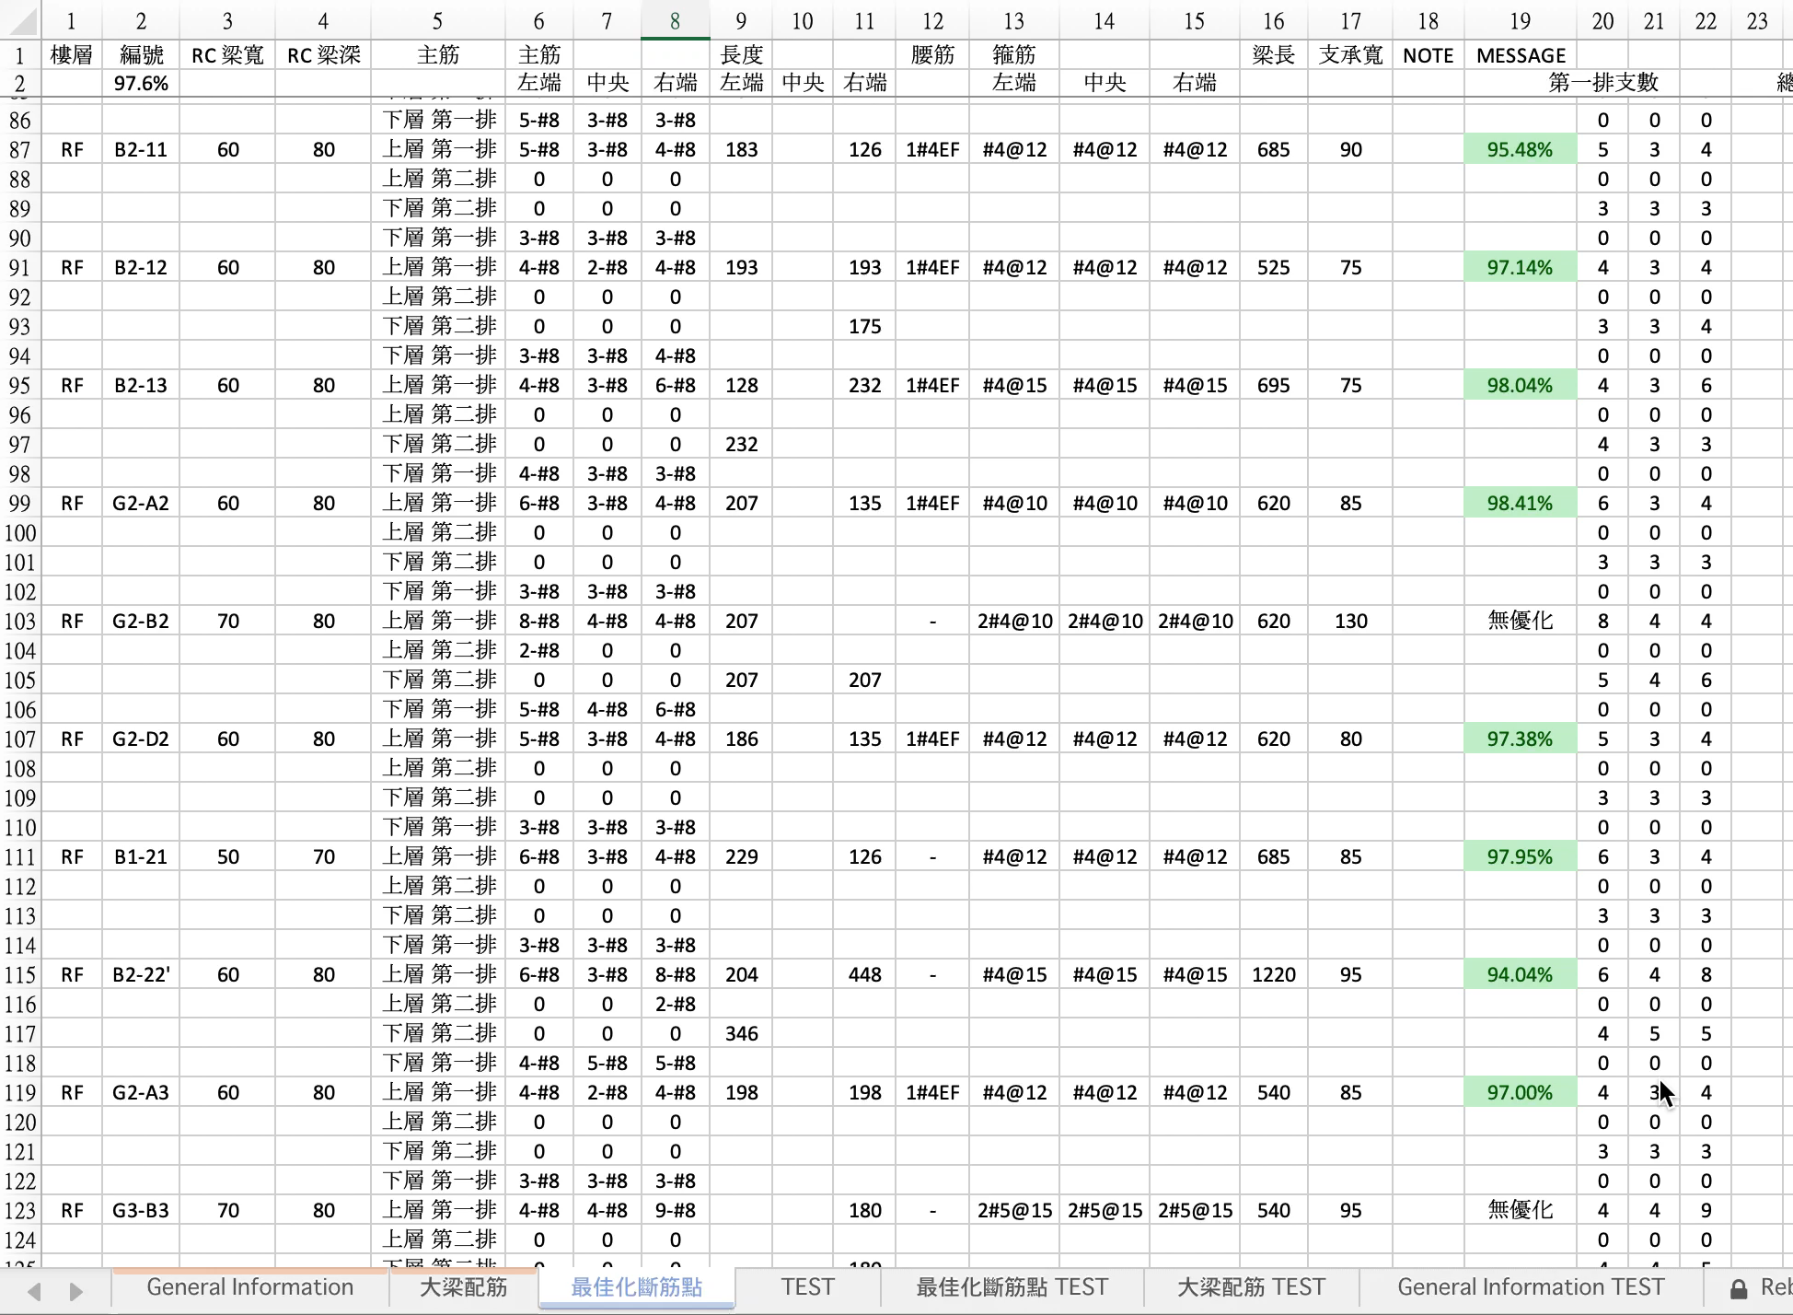

Slide 28
Roadmap
NEXT
NEXT
2019
ETABS/SAP DEMAND
IMPROVE STABILITY AND PERFORMANCE
NONLINEAR TIME HISTORY ANALYSIS
DONE
NEXT
12/2018
FROM EXISTING REBAR
BIG DATA
MULTI-MODES PUSHOVER

Slide 29
PAPER REVIEW
A modal pushover analysis procedure to estimate seismic demands for unsymmetric-plan buildings
A modal pushover analysis procedure for estimating seismic demands for buildings
➔

